Slide 1

MIT 2020
System Design & Management Webinar
Realizing Business Outcomes & Scaling Industrial IoT
Jayraj Nair
Room 9-151 : 12-1pm EST, March 10, 2020

Slide 2

Operate at the intersection
Strategy
Design
Technology
Focus on business outcomes!

Slide 3

Strategy
Improve operational efficiencies (bottom line)
Enable product to service transformation - new revenue streams (top line)
Enhance user experience (customer supplier affinity)
New better ways of working – beyond silos, transformational

Slide 4

Design
Human vs technology centric, people first vs systems, desirability, simplification, focus on user experiences

Slide 5
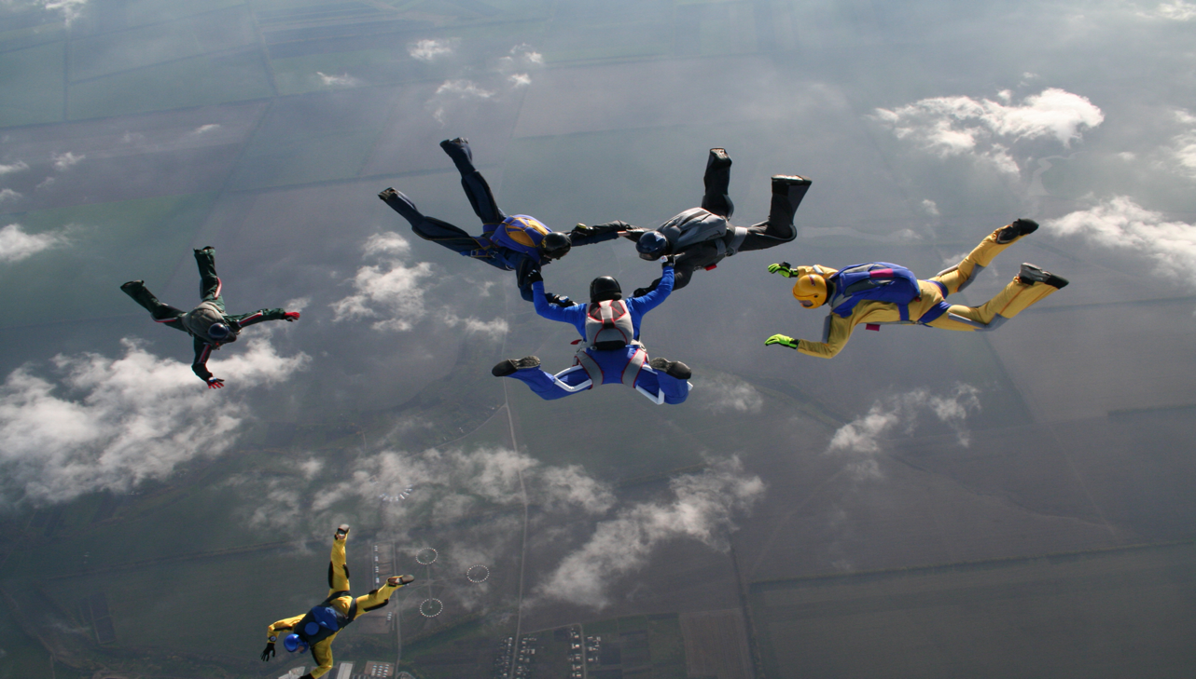
Technology
sensors – connectivity – platforms – enterprise integration - analytics – machine learning – artificial intelligence

Slide 6

Agility
velocity of innovation - Iterative, collaborative, responsive
Use Case
Insights : as-is assessment
Direction : to-be vision
Transformation plan : roadmap
Design & build : rapid prototyping
Deploy: continuous delivery
User
Ref
Stack
Ref
Arch
dspace@mit: user driven product innovation

Slide 7

Systems Thinking
holistic - systems of systems
modular
keep it simple
interoperable
end-user experience, value
discovery-led, iterative
people & process
Life cycle beyond design-build
ecosystem play - heterogenous
scalability, layered architecture
complexity drives costs
any to any
adoption
cicd devops world
service life cycle
support cost & consumption models
Realize business outcomes!

Slide 8

Use Cases
Asset management
Smart manufacturing
Connected supply chain
Logistics & fleet management
Security & surveillance
Worker health & safety
Connected care
Connected vehicle
Connected retail
Smart infrastructure (Airports/Buildings/City et all)
…many others…

Slide 9

Example : Asset Management
(Smart, Connected)

Slide 10
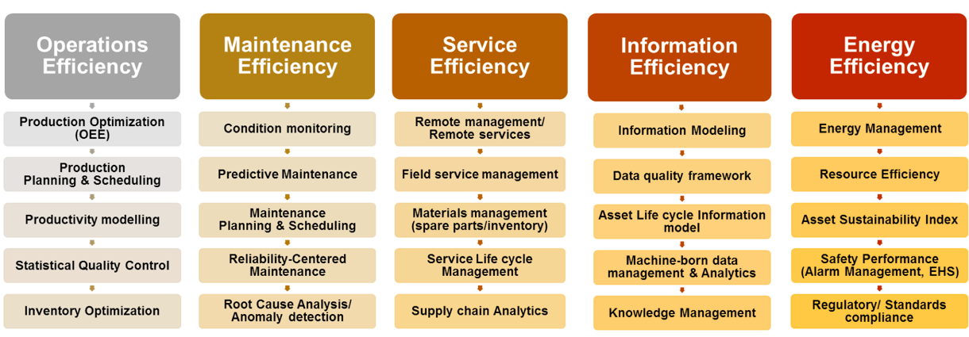
Example : Asset Management
(Sub Use Cases)

Slide 11
Example : Asset Management
(Reference Architecture)
Edge
Platform
Enterprise

Slide 12
Any Device – Any Cloud?
AWS
Azure
IoT Greengrass
Extends capabilities to edge, Local messaging, Security & h/w integrations, ML Inference, Connectors & OTA, Stream Manager, Container support, Secrets Manager , protocol conversion
IoT Sitewise
Ingest, Model, Collection gateway, protocol conversion.
IoT Core
(Managed Service) Device gateway, message broker, registry, rules, device shadow. Provisioning authorizations.
Things graph
Device orchestration, Digital equivalent of Physical
Device Mgmt
Register, organize, remotely manage, fleet (Bulk) provisioning, OTA
AWS Device Defender
Audit (Scheduled or Adhoc) by alerts/profile etc
AWS IoT 1-Click
Hosted low code environment
Edge (FreeRTOS, IoTSDK)
Insights ⬄ Data Analytics
Contextualization & Co-relation
IoT Edge
Runtime + Edge Agent + IoT Hub Edge + (Modules ) + Docker Containers Each Module = Digital Twin, Runtime = secure conn, container mgmt
IoT Hub edge = mimics Hub in cloud
Sphere
H/w+OS+Cloud components. Certified chips, sphere os, security service. Root of trust, cert based auth
IoT Hub
Securing, Configuring, Provisioning & Managing
Digital Twins
Model of physical (Device ontology) Smart spaces, asset classes etc
IoT Central
Per device hosted low code environment PaaS
Condition monitoring etc
Edge (IoTSDK)
Azure Maps
geospatial API’s, Mobility – Traffic, routing, Geoloc, Time zones, location intelligence
Azure Time Series Insights
Data exploration, operational, advanced analysis, visual (PowerBI), anomaly detection ..etc
AWS IoT Analytics
Many – to – Many
Channels to Pipeline to Data Store, Channels are bridge to IoT Core, pipeline is for cleansing/transformation Uber version of ETL’s.
Data Store – optimized DS built in SQL
AWS Quicksight
IoT Events – detection/actions etc
AWS Sitewise – Ingest, Model, Store, Process

Slide 13
Any Device - Any Application – Any Cloud
(Essential Digital Foundation)
Credit :VMware

Slide 14
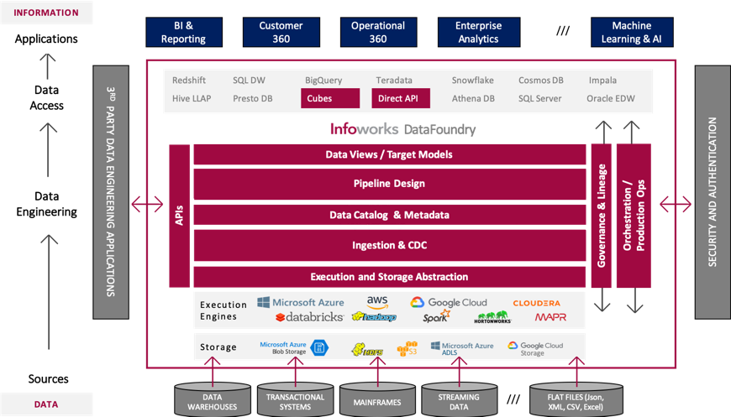
Any Data – Any Application – Any Time
(Essential Digital Foundation)
Credit :Infoworks

Slide 15


Any to Any
(Ecosystem play)
Interoperable, On demand, elastic, scalable
Multi-partner, modular, heterogenous – interoperable systems

Slide 16
End-User : Top of Mind !
Support for multi-cloud, hybrid infrastructure (Cloud Agnostic)
Pervasive security (edge to cloud) – policies independent of h/w, OS, Apps
Operations w/ single pane of glass for OT-IT
Design - Build – Deploy – Operate (Ease & Consistency)
Abstraction, Automation, Total Cost of Ownership

Slide 17
Summary : Systems Thinking
holistic - systems of systems
modular
keep it simple
interoperable
end-user experience, value
discovery-led, iterative
people & process
Life cycle beyond design-build
ecosystem play - heterogenous
scalability, layered architecture
complexity drives costs
any to any
adoption
cicd devops world
service life cycle
support cost & consumption models
Iterate & Realize business outcomes!

Slide 18

Q&A
Thank you
Enjoy spring break!

