Slide 1
Creating Products, Services, and Infrastructure for a Space-Faring Economy
Eric Ward
CEO, Odyne Space,
CEO, Aten Engineering,
SDM Alumnus

Slide 2
Webinar Contents
Reasons to Become Space-Fairing
  Curiosity
  Science
  Humanity’s Backup
  Natural Resources
Gaps in Infrastructure, Products and Services
  Cubesats
    MicroLaunch
  Rocket Equation
    ISRU

Slide 3
Reasons to Become Space-Fairing
Reasons
Why do we need to get to space?
Curiosity
Science
Backup
Growth

Slide 4
Curiosity & the Human Spirit
Reasons
Curiosity and the drive for exploration, all supported by going into the next frontier. As Gene Roddenberry has made us all very aware of, Space is the [next] frontier.
It is also argued that there is a moral imperative to experience ‘fresh canvas’ that a new planet could provide.¹
Similarly, becoming interplanetary has the potential to greatly alter the intellectual potential, diversity, and culture of the human race.²
These ‘aspirational’ motivations drive a lot of Space enthusiasts and professionals.
1.Dr. E. R. Klein, “Space Exploration: Humanity’s Single Most Important Moral Imperative” Philosophy Now, Aug 2007, accessed Sept 10 2017, https://philosophynow.org/issues/61/Space_Exploration_Humanitys_Single_Most_Important_Moral_Imperative
2.L.A. Crawford, “Stapeldon’s Interplanetary Man: A Commonwealth of Worlds and the Ultimate Purpose of Space Colonization”, JBIS, Val. 65, pp 13-19, 2012.
Notes:
Di

Slide 5
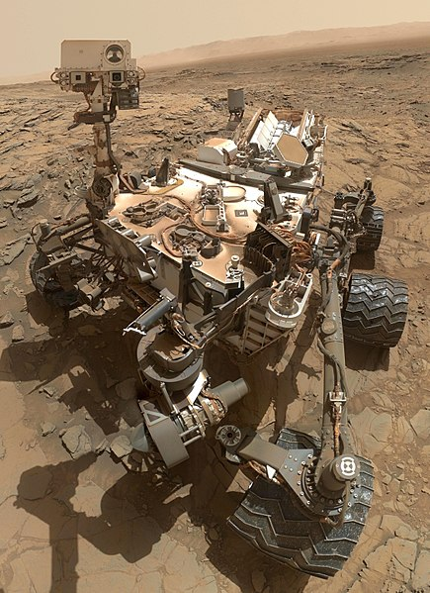
Understanding the Universe
Reasons
We can observe a lot remotely, but there are undeniable benefits from going in person.
Future value of scientific research is very difficult to quantify and estimate.
Courtesy: NASA

Slide 6
Humanity’s Backup Plan
Reasons
A contemporary favorite, spearheaded most notably by Elon Musk¹ and Stephen Hawking,² is that planetary colonization is essential to the survival of the species in the face of planetary extinction events.
Some argue that it is unethical not to colonize another planet, from the perspective of the (currently perceived) uniqueness of intelligence.
1. Tim Urban, “How (and why) SpaceX will colonize Mars Part Two: Musk’s Mission”, Wait But Why, Accessed August 10th 2014, https://waitbutwhy.com/2015/08/how-and-why-spacex-will-colonize-mars.html/2
2. Roger Highfield, “Colonies in space may be only hope, says Hawking” The Telegraph, accessed Sept 10, 2017, http://www.telegraph.co.uk/news/uknews/1359562/Colonies-in-space-may-be-only-hope-says-Hawking.html.

Slide 7
Humanity’s Backup Plan
Reasons
Technology Windows¹ create a ‘short’-term imperative to colonize to a self-sufficient level, before we lose the capability.
Technology Capability
Time
Actual Capability
1. Chris Heath, “How Elon Musk Plans on Reinventing the World (and Mars)”, GQ, December 12th 2015.
General Upward Trend
Space-fairing Capability

Slide 8
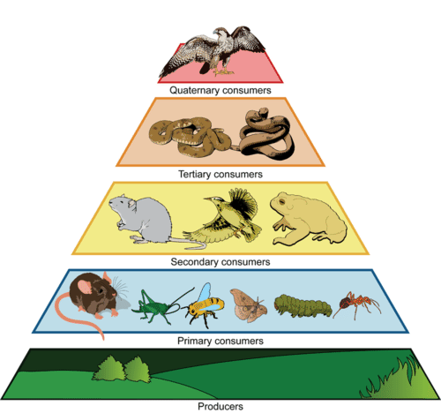
Pillar of Growth in a Trophic System
Reasons
We are a trophic society, fundamentally supported by natural resources¹. To increase the GDP of [a group] they must either find more natural resources, or find ways to more efficiently utilize the ones that they have.
Image: https://www.ck12.org/biology/trophic-level/lesson/Trophic-Levels-BIO/
1, CASSE, “Steady State Economy FAQs” (Center for the Advancement of the Steady State Economy), accessed October 23, 2014, http://steadystate.org/discover/faqs.

Slide 9
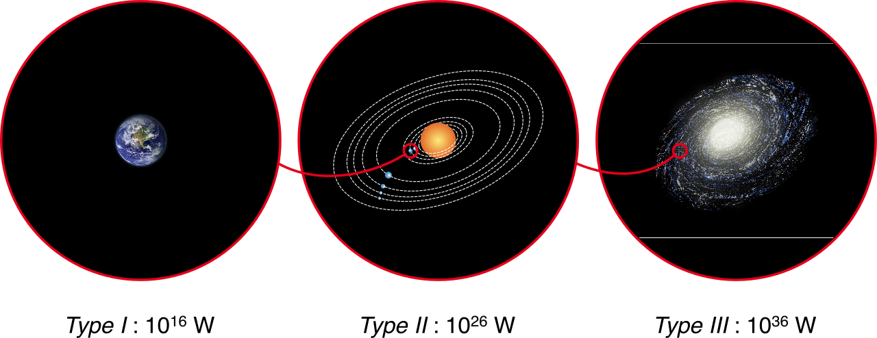
Natural Resources are Fundamental to Growth
Reasons
If you take the group to be humanity as a whole, it becomes clear that one of the pillars of continued growth as a species is exploring the (closest) unknown regions of our universe and discovering and utilizing resources outside of our planet.
Kardashev Scale
  (We are Type 0!)
^{CC BY-SA 3.0, Indif}

Slide 10
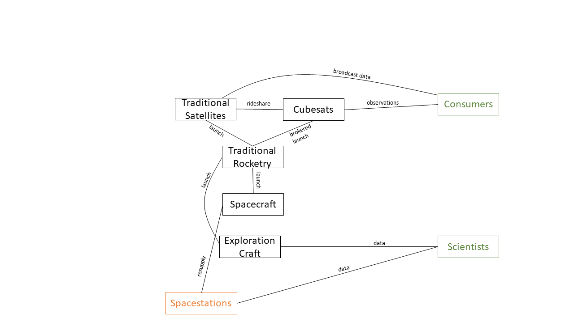
Gaps in Infrastructure, Products and Services
Gaps
Spacecraft : Watercraft :: Spaceship : Ship
  We’re flying spacecraft now.
  How do we get
  to spaceships?

Slide 11
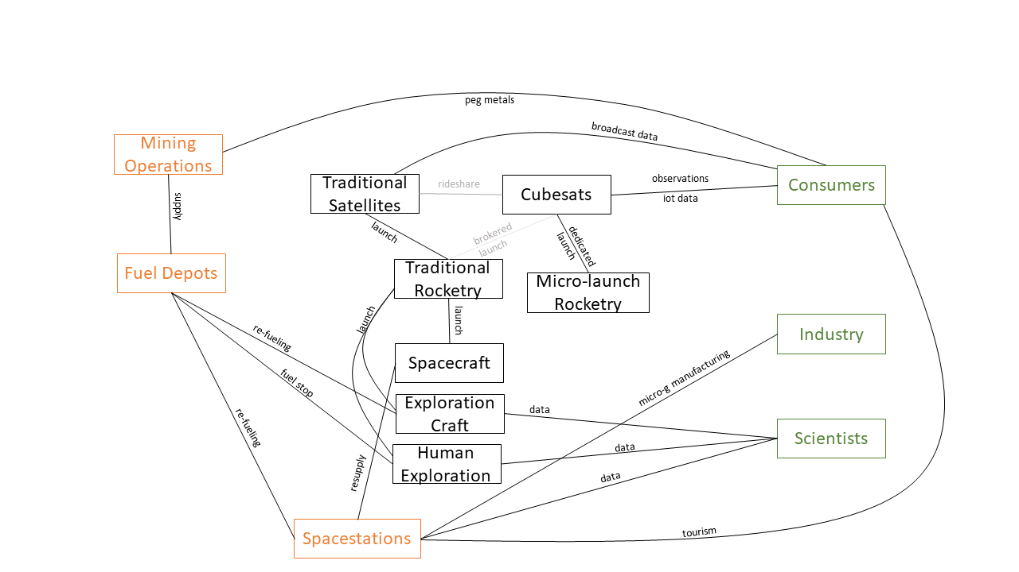
Gaps in Infrastructure, Products and Services
Gaps

Slide 12
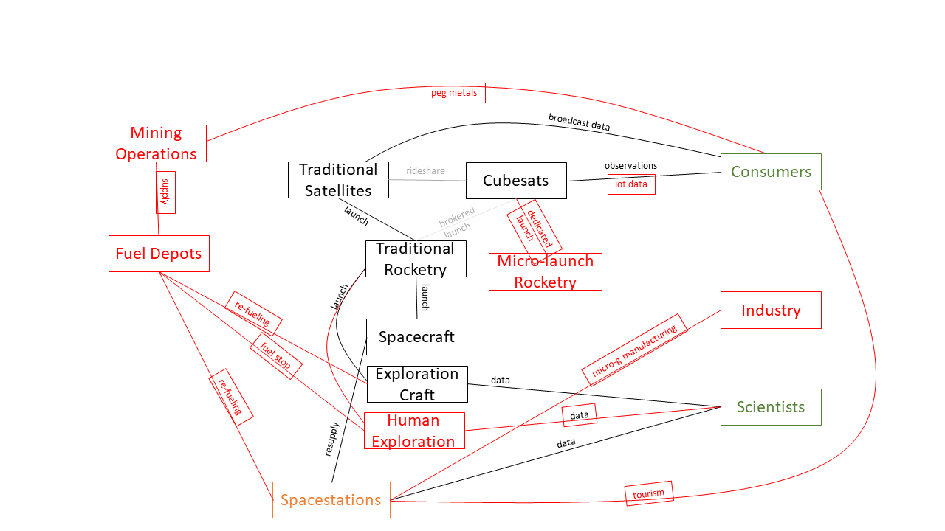
Gaps in Infrastructure, Products and Services
Gaps

Slide 13
Gaps in Infrastructure, Products and Services
Gaps
The importance of Cubesats
Cubesat Gaps
Rocket Equation
ISRU

Slide 14
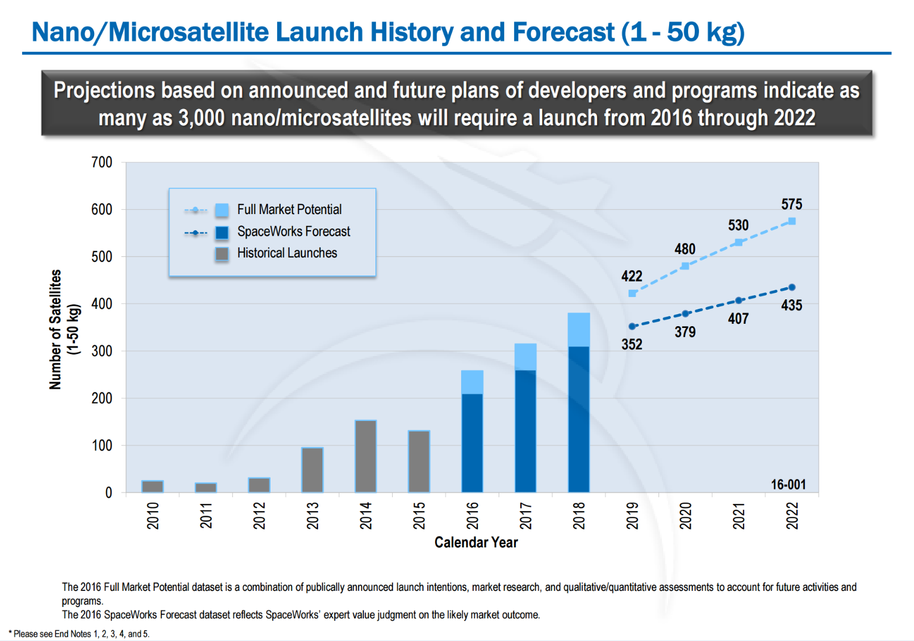
Cubesats
Gaps
Cubesats are fast becoming the Workhorse of the Space Economy.

Slide 15
Cubesat Gaps: Micro-launch
Gaps
Large gap for cubesat growth
24% predicted 5 year CAGR for cubesats, capped by availability of Launches
Data: Spaceworks 2014 and IDA

Slide 16
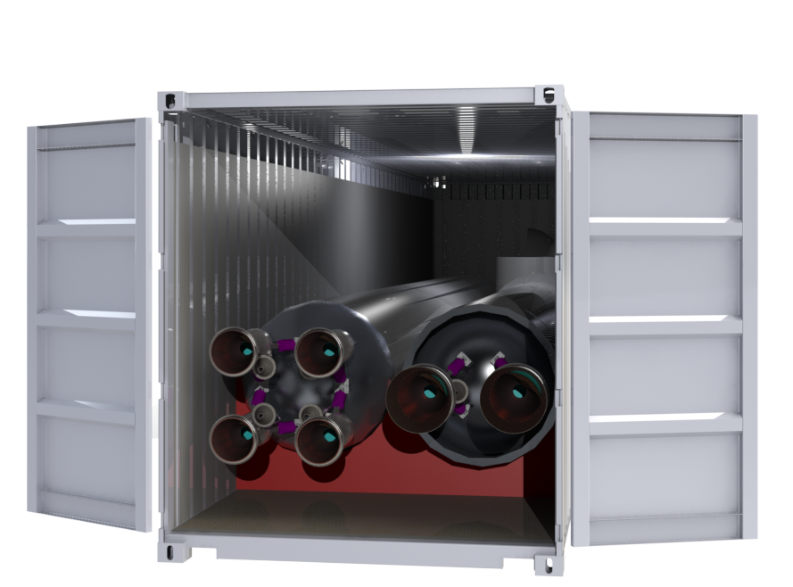
Cubesat Gaps: Micro-launch
Gaps
Micro-Launch will need intelligent systems design to be successful
eg. Integrated
systems-design
^{Courtesy: Odyne Space}
Data: Spaceworks 2014 and IDA

Slide 17

Cubesat Gaps: Communication
Gaps
High-Bandwidth Comms
  eg. Kit Cube
  As Cubesat data becomes more and more prevalent, communication bandwidth becomes saturated
  Important to enable new markets, such as satellite-based IoT.
^{Courtesy: MIT Kit Cube}

Slide 18
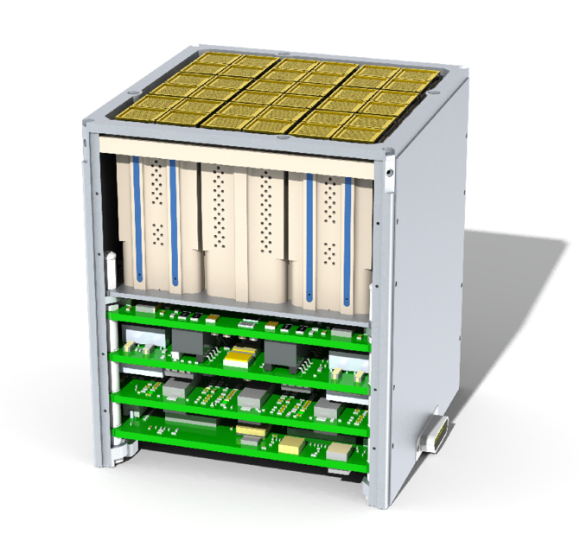
Cubesat Gaps: Propulsion
Gaps
Cubesat-class Propulsion
  eg. Accion Systems
  Enables:
    Longer orbital life
    Station keeping
    Rapid orbital spacing
  Allows:
    Novel mission profiles
    Flexible operations
^{Courtesy: Accion Systems}

Slide 19
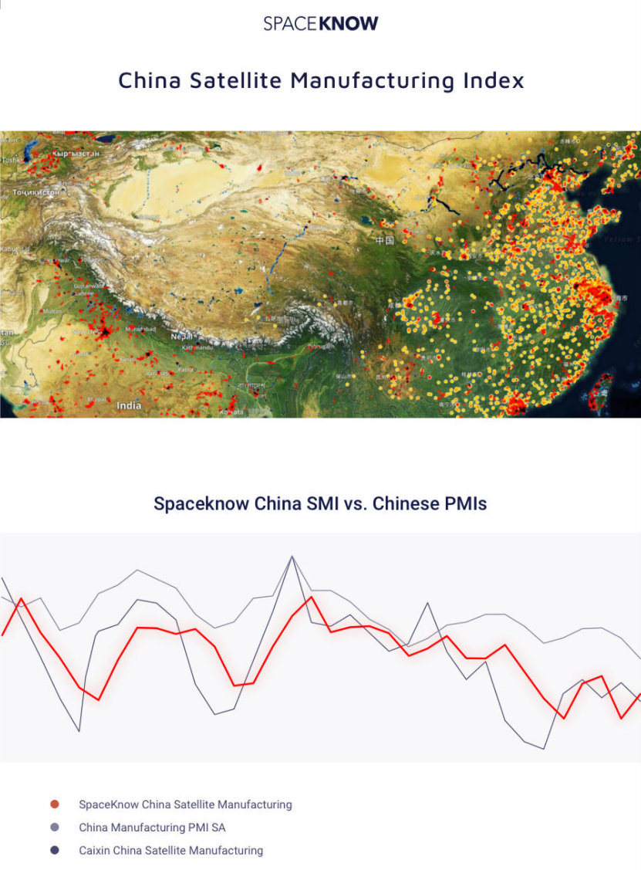
Cubesat Gaps: Data
Gaps
Other Gaps for Cubesat growth
  Data Management and Analysis
    eg. SpaceKnow
  Downstream added value through the analysis of space-based data.
^{Courtesy: SpaceKnow}

Slide 20
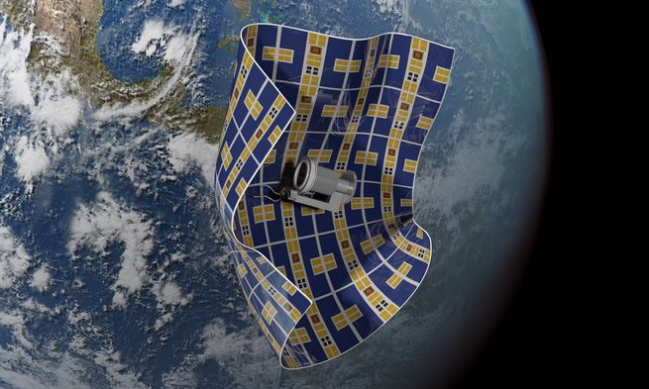
Cubesat Gaps: Other
Gaps
Other Gaps for Cubesat growth
  Space Junk Cleanup
  Satellite Servicing
  Market Differentiation is becoming important!
Courtesy: The Aerospace Corporation

Slide 21
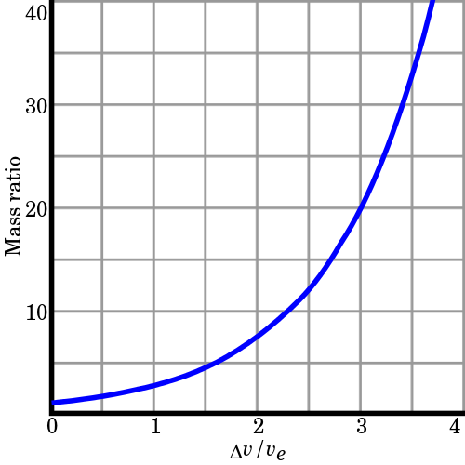
Tyranny of the Rocket Equation
Gaps
The logarithmic nature of the Rocket Equation makes it ‘tyrannical’, in that each marginal increase in payload (including fuel for future legs) requires an exponentially larger amount of fuel than the last.
Furthermore, there is almost no way to get around the requirement for more fuel (without, at least, sacrifices to other mission parameters.)

Slide 22
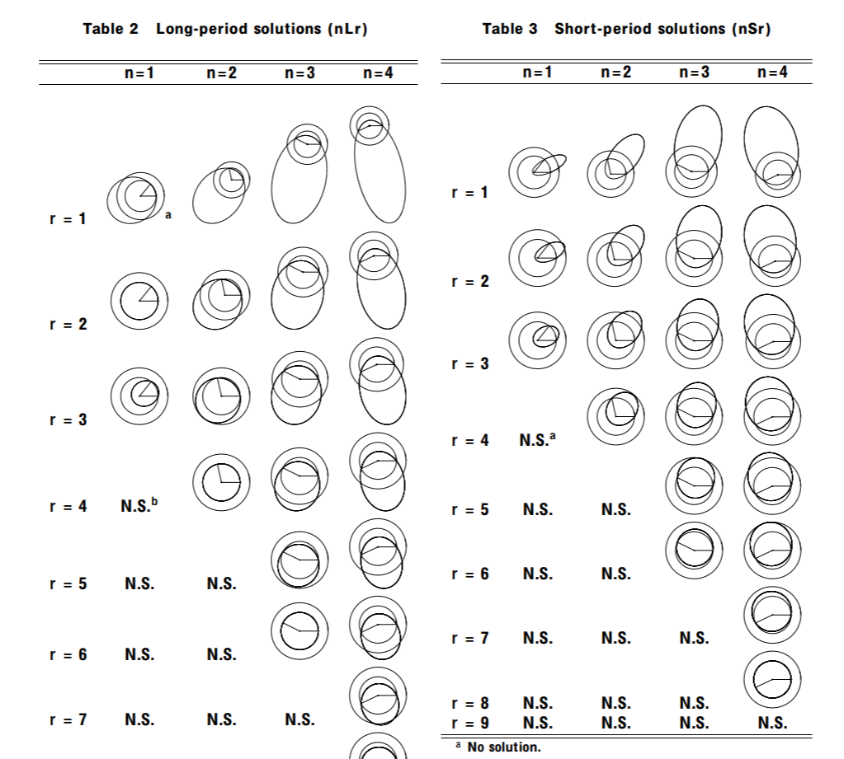
Skirting the Rocket Equation
Gaps
Gravity Assists
Oberth Maneuver
Reducing Mass
Reusing Mass
  Earth-Mars Cycler
McConaghy, Longuski & Byrnes, “Analysis of a Broad Class of Earth-Mars Cycler Trajectories” AIAA-2002-4420

Slide 23
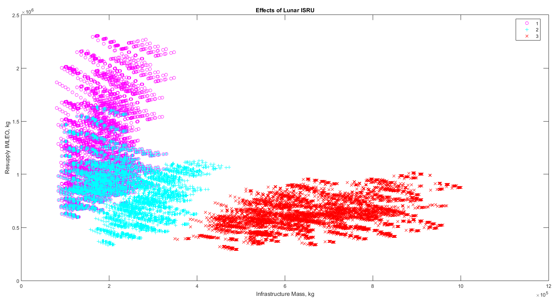
Avoiding the Rocket Equation
Gaps
In-Space Resource Utilization

Slide 24
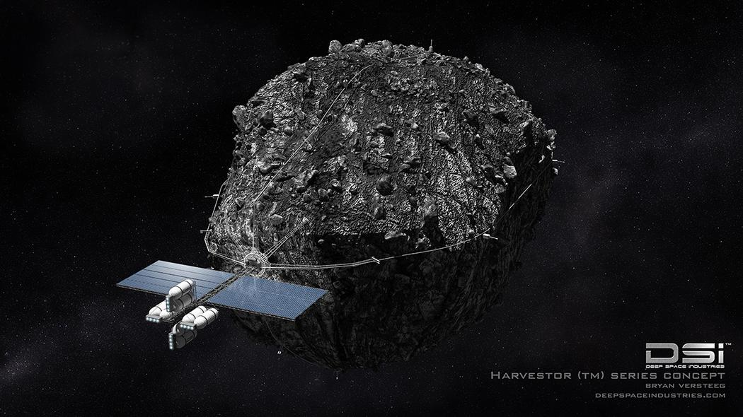
ISRU Gaps: Micro-g Mining
Gaps
Mining Technology
Ore Collection
Courtesy: Deep Space Industries

Slide 25
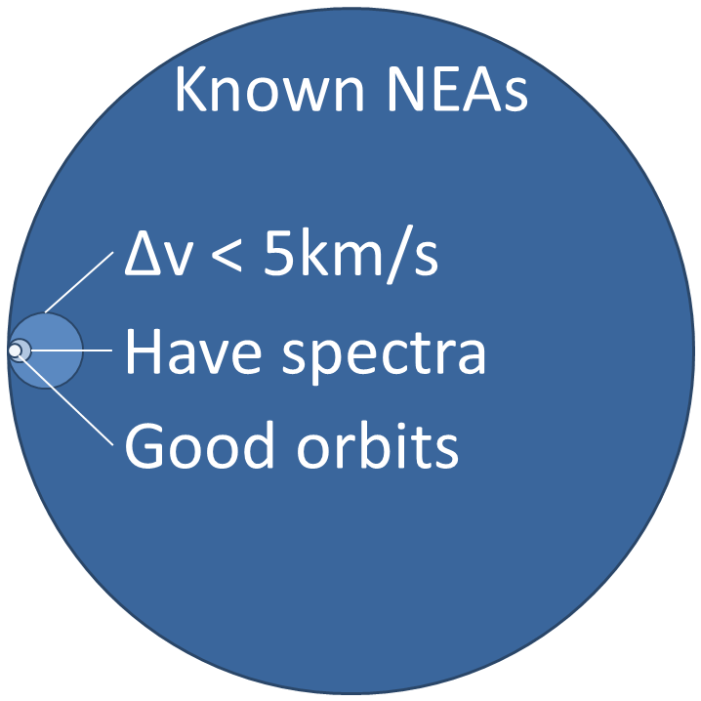

ISRU Gaps: Maps
Gaps
Ore-bearing Asteroids need to be Discovered, Catalogued and Tracked.
16,000
770
80
25
^{Courtesy: Aten Engineering}

Slide 26
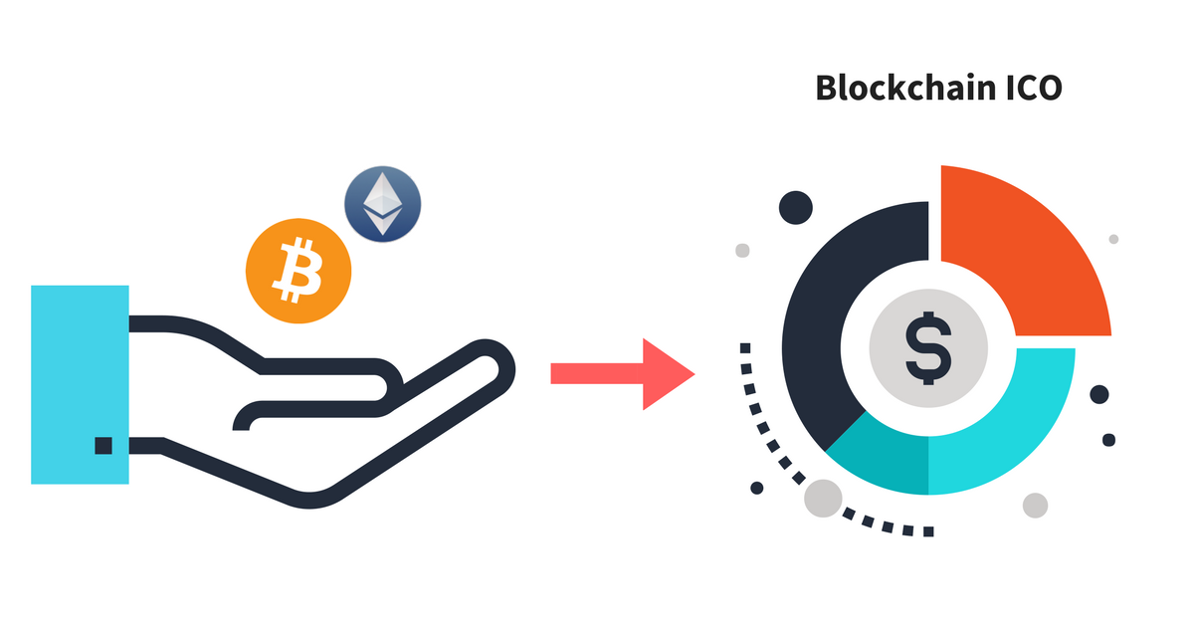
ISRU Gaps: Economic Tools
Gaps
Investments
Insurance
Financial Instruments
Real/Technical Options
^{Courtesy: blockgeeks}

Slide 27
Gaps in Infrastructure, Products and Services
Gaps

Slide 28
Fin.
Thank you for your attention.
ericward@alum.mit.edu

